Slide 1

MIS Analyst Internship – Business Intelligence & Automation
Mentor & Guide:
Mr. Kadhiravan Jayachandira
PRESENTED BY:
KEDARI SRI VENKATESH

Slide 2
Acknowledgment
My Clear Statement:
I would like to express my sincere gratitude to Mr. Kadhiravan Jayachandiran, my Mentor & Guide, for his continuous guidance, valuable insights, and support throughout my MIS Analyst internship at KultureHire. His mentorship helped me develop practical skills in data analysis, SQL, dashboard development, and automation, making this internship a valuable learning experience.
Learning & Growth
Gratitude to KultureHire
This internship strengthened my technical and professional skills, including data management, business analysis, problem-solving, and communication. It has prepared me to confidently pursue a career in Management Information Systems and Business Intelligence.
I sincerely thank KultureHire for providing me with the opportunity to work as an MIS Analyst Intern. The internship offered valuable exposure to real-world business analytics, reporting, dashboard development, and automation.

Slide 3
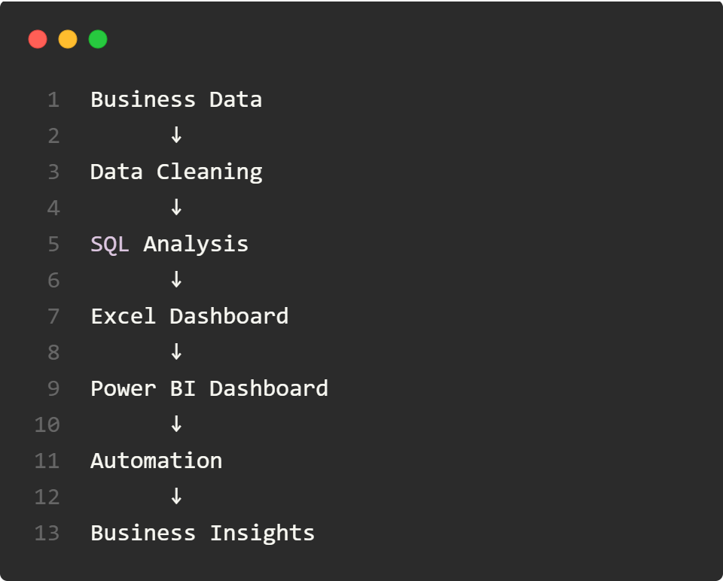
Project Overview:
During my internship at KultureHire, I worked on end-to-end MIS reporting by transforming raw business data into meaningful insights. The internship covered data collection, cleaning, SQL querying, dashboard development, and process automation.
Project Overview
& Objectives
Internship Workflow
Objectives:
Understand the responsibilities of an MIS Analyst.
Collect and organize business data.
Clean and standardize datasets.
Perform descriptive and diagnostic analytics.
Query relational databases using SQL.
Develop interactive Excel and Power BI dashboards.
Automate repetitive reporting tasks using Google Apps Script.

Slide 4
Data Sources & Tools Used
Data Sources
Tools Used
Business operational data
Finance records
Sales/performance data
Business datasets
Excel spreadsheets
SQL database
Google Automation
Tool | Purpose
Microsoft Excel | Data Cleaning & Dashboarding
Power Query | Data Transformation
SQL | Data Querying
Power BI | Interactive Dashboards
Google Apps Script | Process Automation
Google Sheets | Data Storage & Reporting

Slide 5
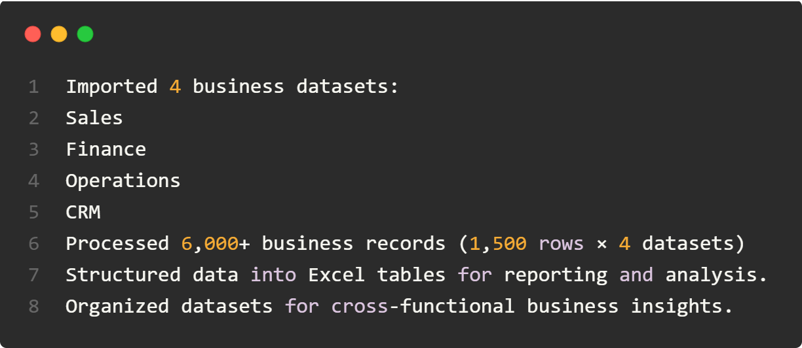
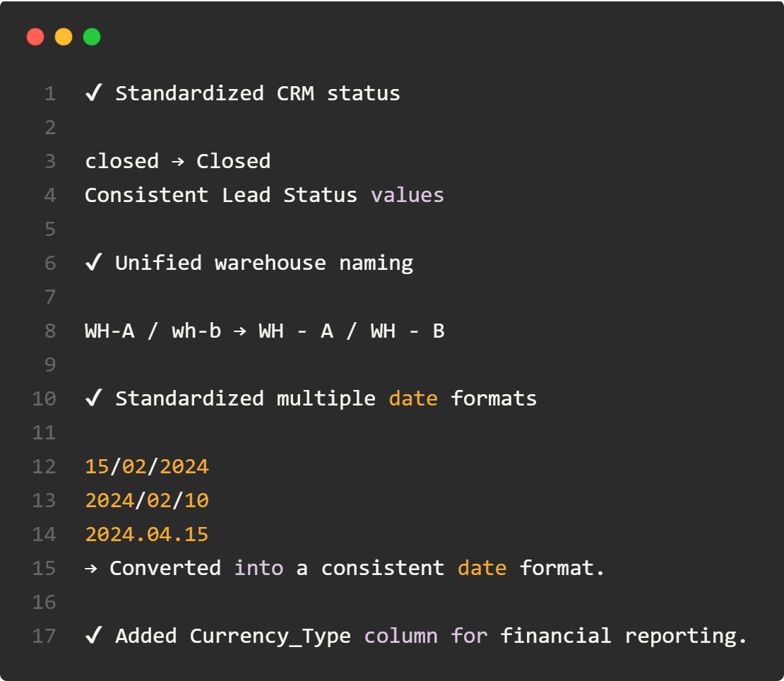
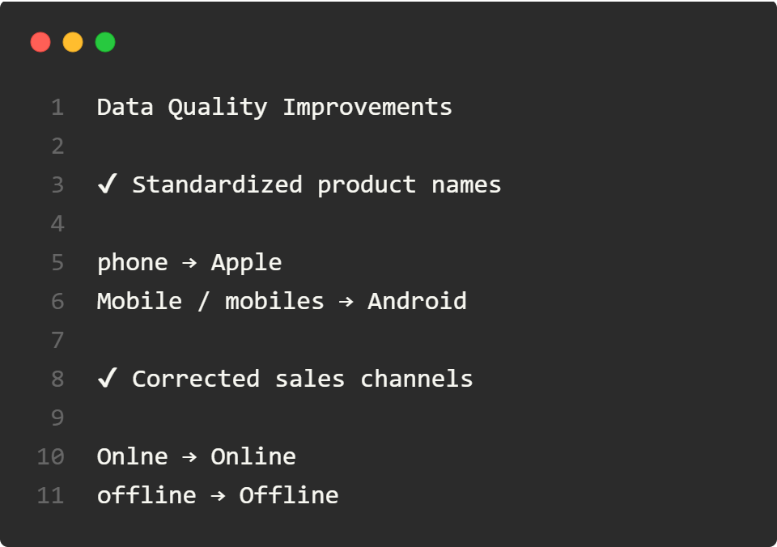
Data Preparation & Standardization
1. Collect, Import & Structure Business Data
2. Data Cleaning & Standardisation

Slide 6
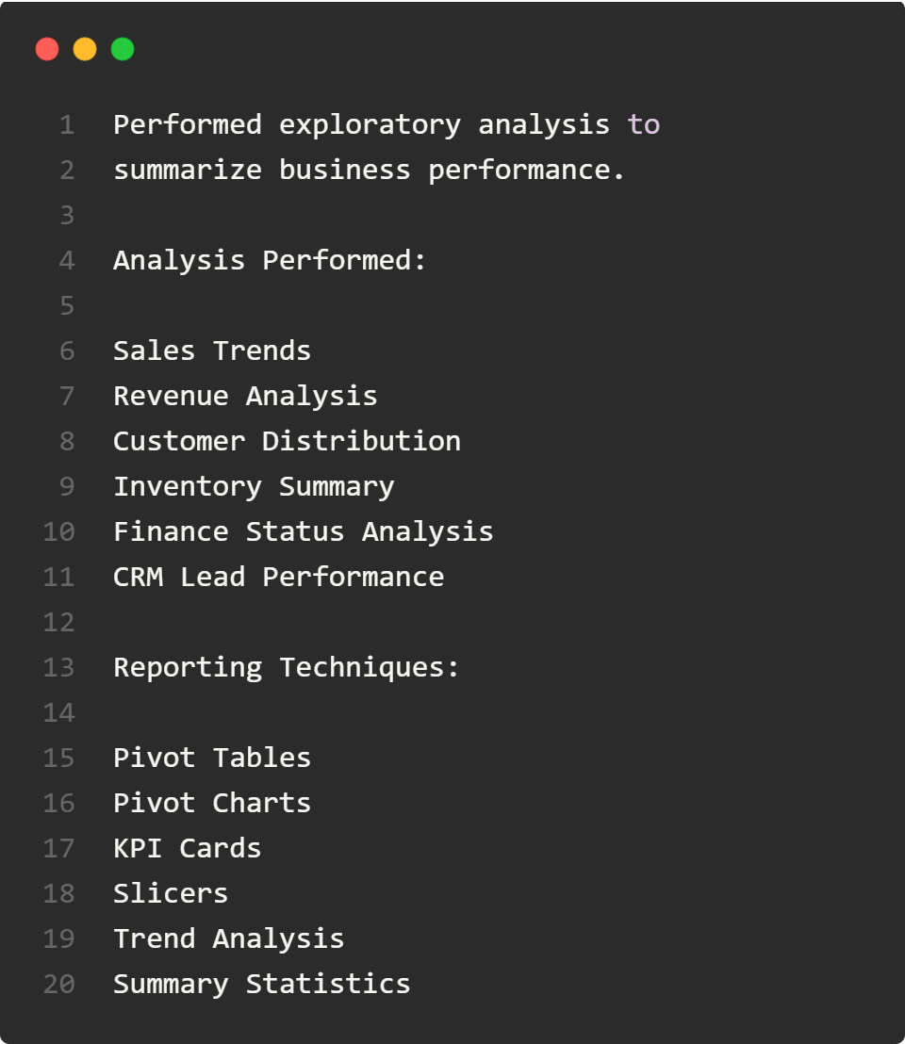
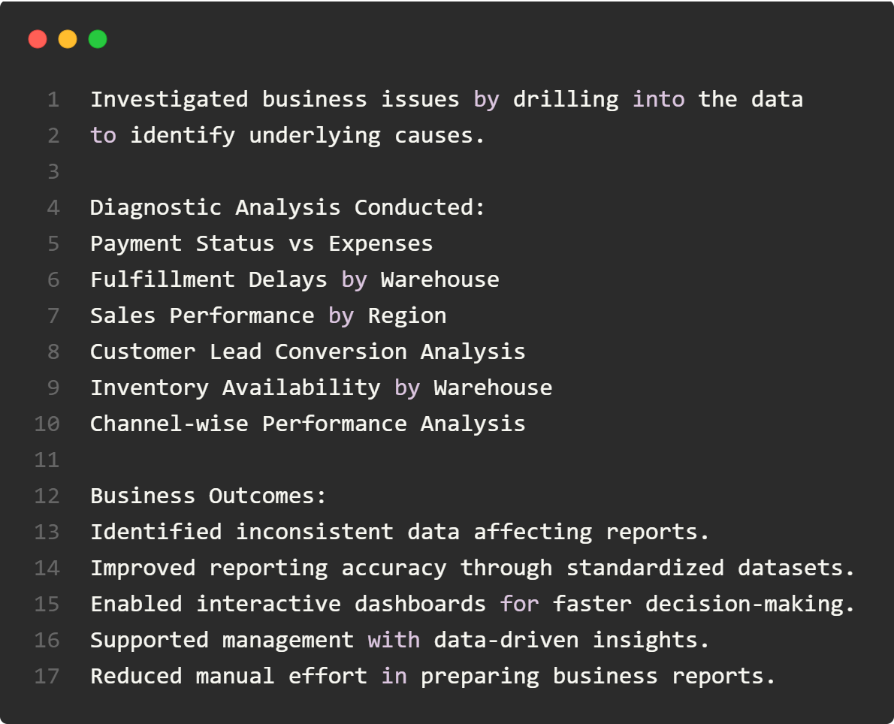
Analytics & Business Insights
3. Analytics & Business Insights
4. Diagnostic Analytics – Root Cause Analysis

Slide 7
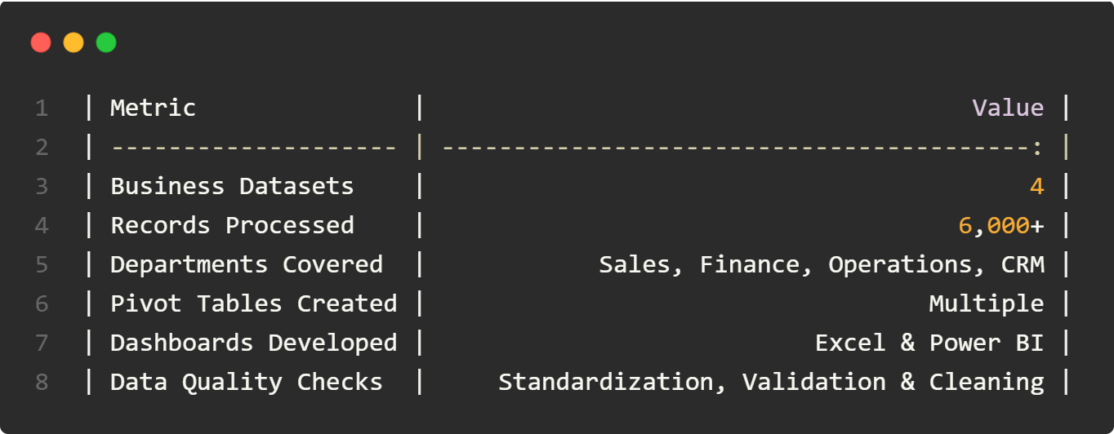
Key Highlights and Use KPI Boxes:
Key Highlights:
📊 4 Business Departments
📁 6,000+ Records Processed
🧹 Data Cleaning & Validation
📅 Date Format Standardization
🏷 Category Standardization
📈 Analysis-Ready Dataset
Use of KPI Boxes:

Slide 8
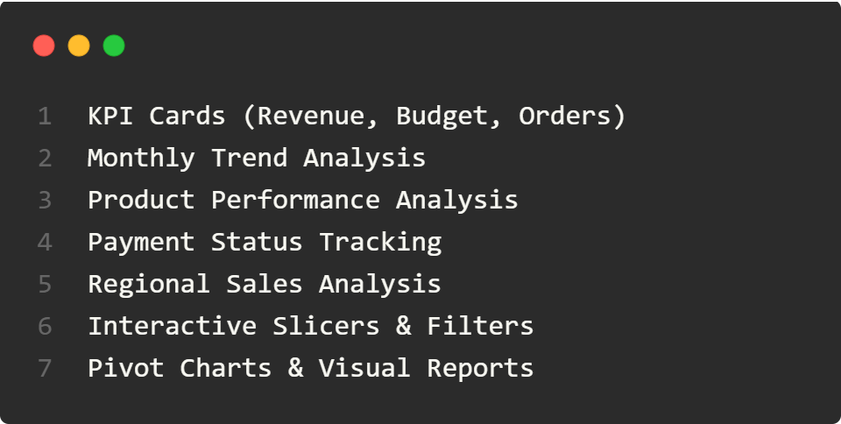
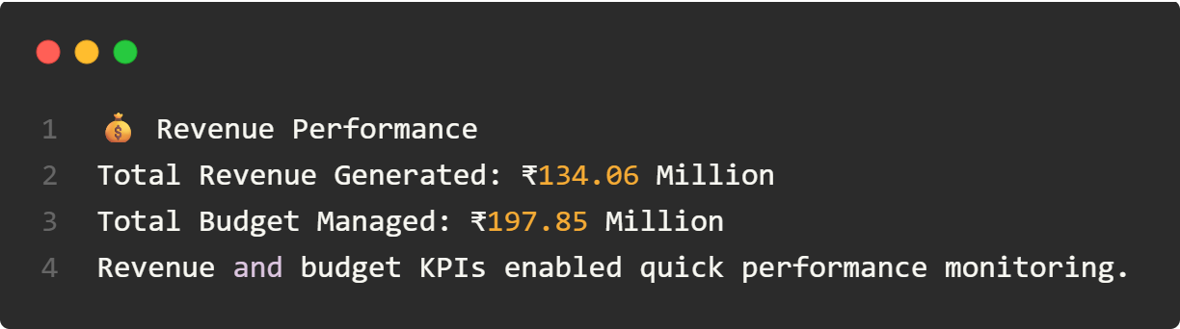
Key Insights from Dashboards
📊 Dashboard Features
📈 Key Business Insights

Slide 9
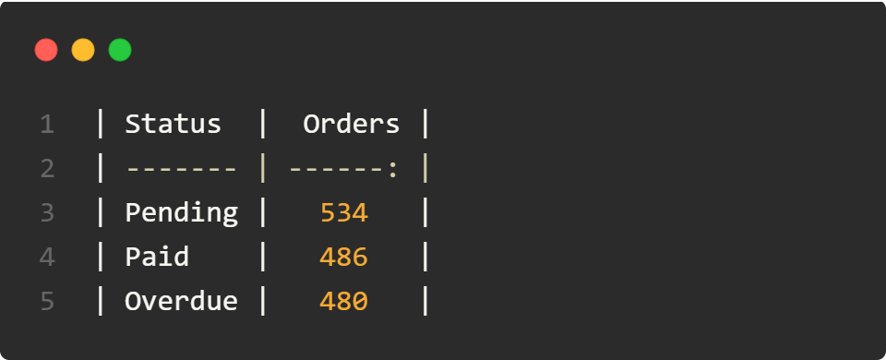
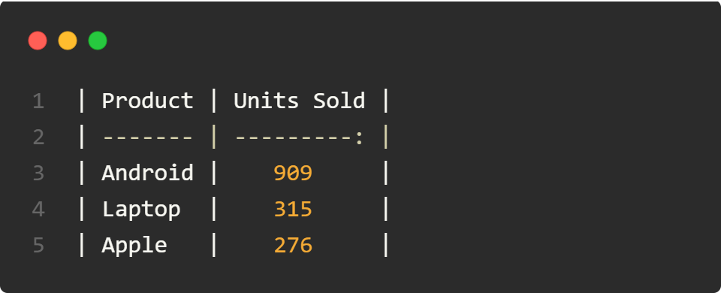
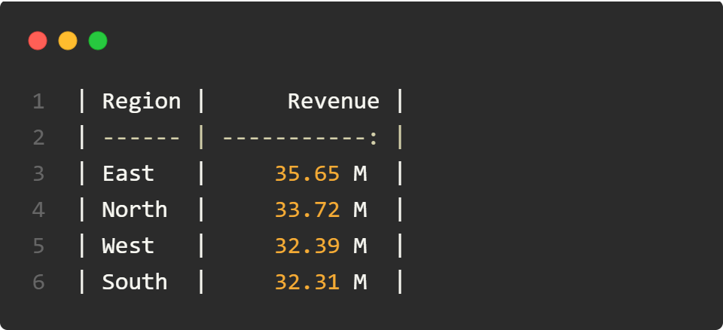
Key Analysis:
🛒 Product Performance
🌍 Regional Sales Performance
💳 Payment Status Analysis
Insight: Android products accounted for approximately 61% of total units sold (909 of 1,500), making them the highest-selling category.
Insight: The East region generated the highest sales revenue, while South showed the lowest overall performance.
Insight: Pending payments represented the largest share, indicating opportunities to improve collection and follow-up processes.

Slide 10
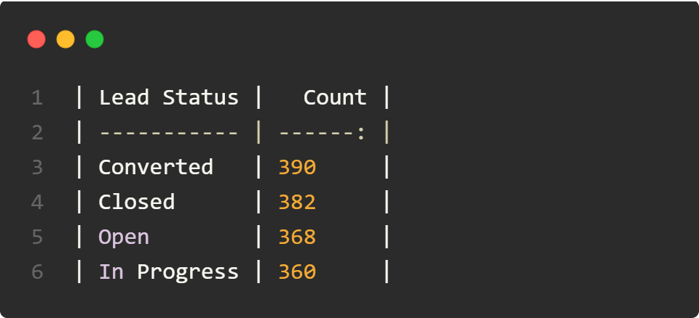
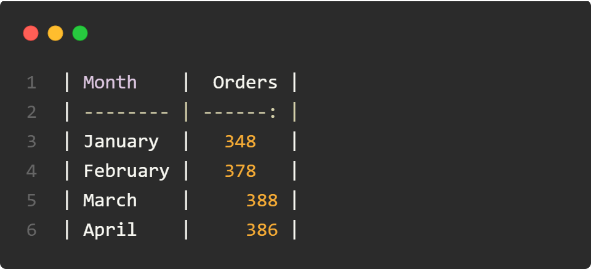
Key Insights:
📌 CRM Lead Status
📅 Monthly Business Activity
Insight: Converted leads formed the largest group, while a significant number of open and in-progress leads suggest additional conversion opportunities.
Insight: Business activity increased steadily from January to March and remained consistently high in April, indicating stable operational performance.

Slide 11
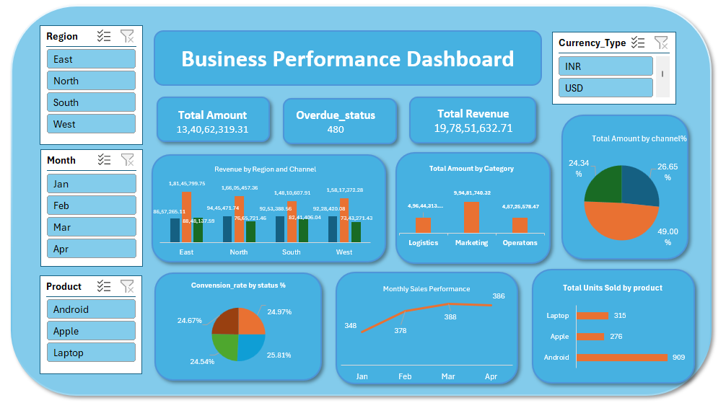
Excel dashboard:

Slide 12
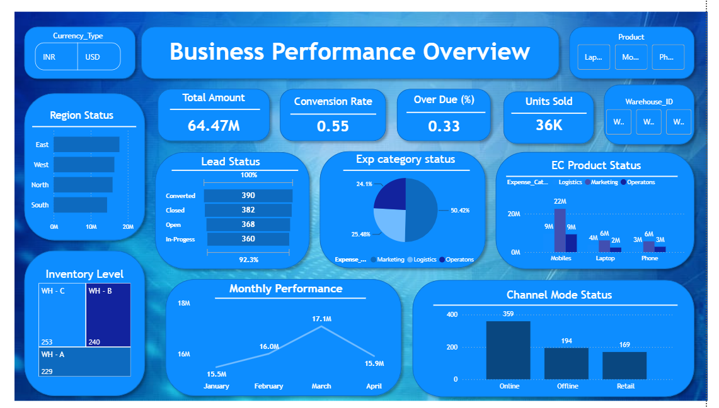
PowerBI dashboard:

Slide 13
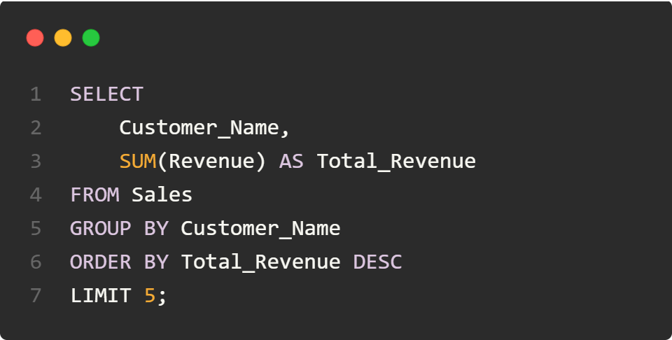
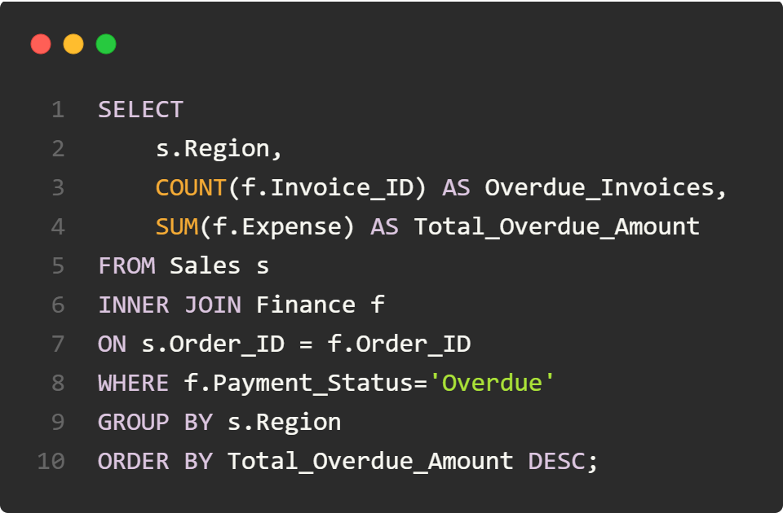
SQL Use Cases & Findings
Top 5 Customers by Total Revenue
Overdue Payments by Region (JOIN Sales & Finance)

Slide 14
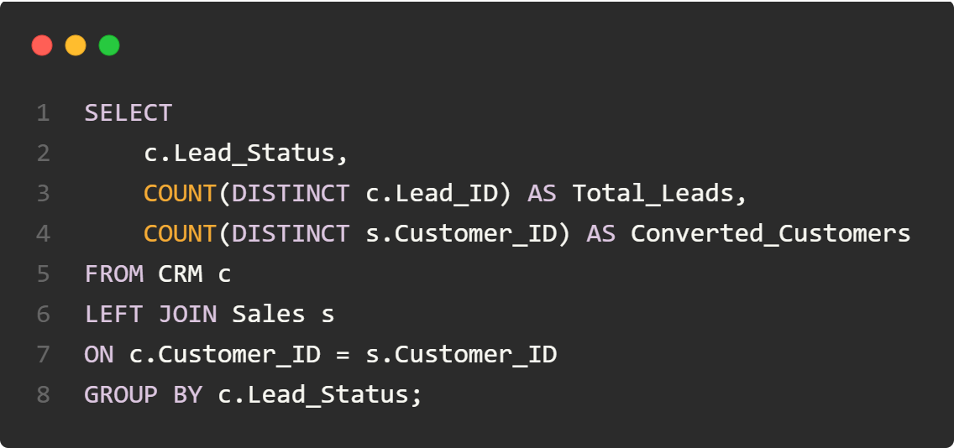
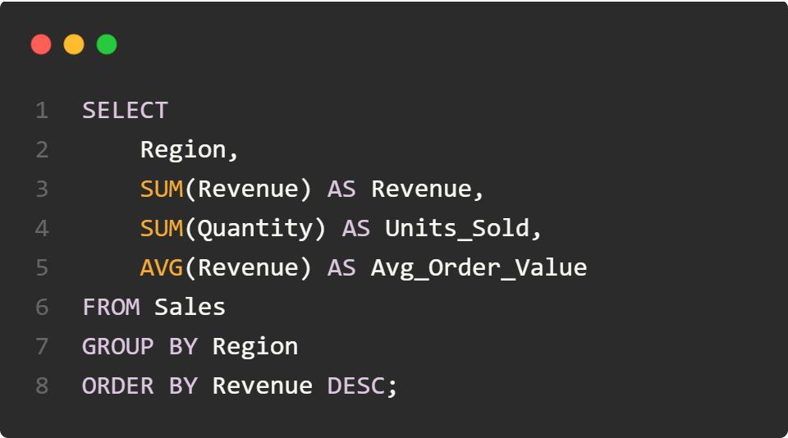
SQL Use Cases & Findings
Lead-to-Sale Conversion Funnel (JOIN CRM & Sales)
Department Performance Analysis

Slide 15
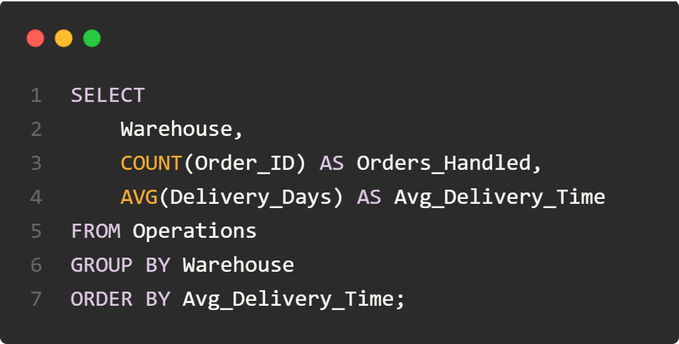
SQL Use Cases & Findings
Warehouse Performance Analysis

Slide 16
Automation Using Google Appscript
Automated MIS Report Generation &
Email Notification using Google Apps Script.
Process
Read Finance dataset
Filter overdue invoices
Generate personalized email
Send reminder automatically
Schedule daily execution
Tools Used
Google Sheets
Google Apps Script
Gmail Service
Time-based Trigger
Outcome
Reduced manual follow-up effort
Improved payment collection efficiency
Automated customer notifications
Ensured timely communication with overdue customers

Slide 17
Automation Using Google Appscript
sendOverdueInvoiceAlerts:
function sendOverdueReminders() {
const sheet = SpreadsheetApp.getActiveSpreadsheet()
.getSheetByName("Finance");
const data = sheet.getDataRange().getValues();
for (let i = 1; i < data.length; i++) {
const customer = data[i][1];
const email = data[i][2];
const amount = data[i][3];
const dueDate = data[i][4];

Slide 18
Automation Using Google Appscript
const status = data[i][5];
if (status === "Overdue") {
const subject = "Payment Reminder - Outstanding Invoice";
const body =
`Dear ${customer},
Our records indicate that your payment of ₹${amount} was due on ${dueDate}.
Kindly complete the payment at your earliest convenience.
If payment has already been made, please ignore this message.
Thank you.
Finance Department`;
MailApp.sendEmail(email, subject, body);
}
}
}

Slide 19
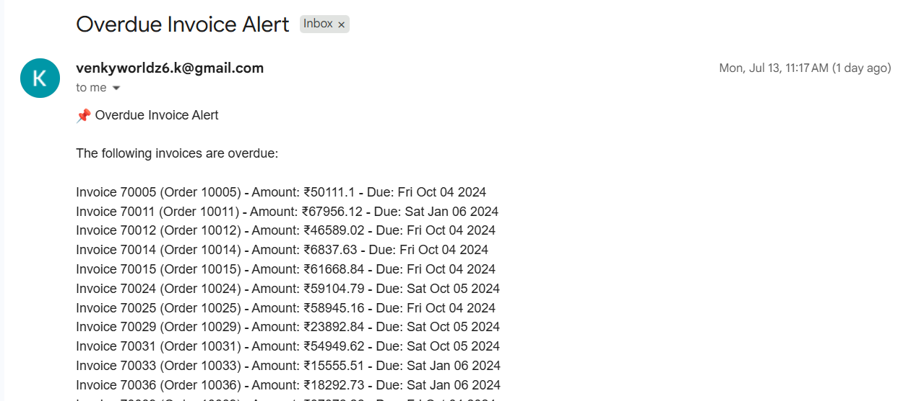
Automate Mail Output

Slide 20
THANK YOU
Mentor & Guide:
Mr. Kadhiravan Jayachandira
PRESENTED BY:
KEDARI SRI VENKATESH

